Slide 1
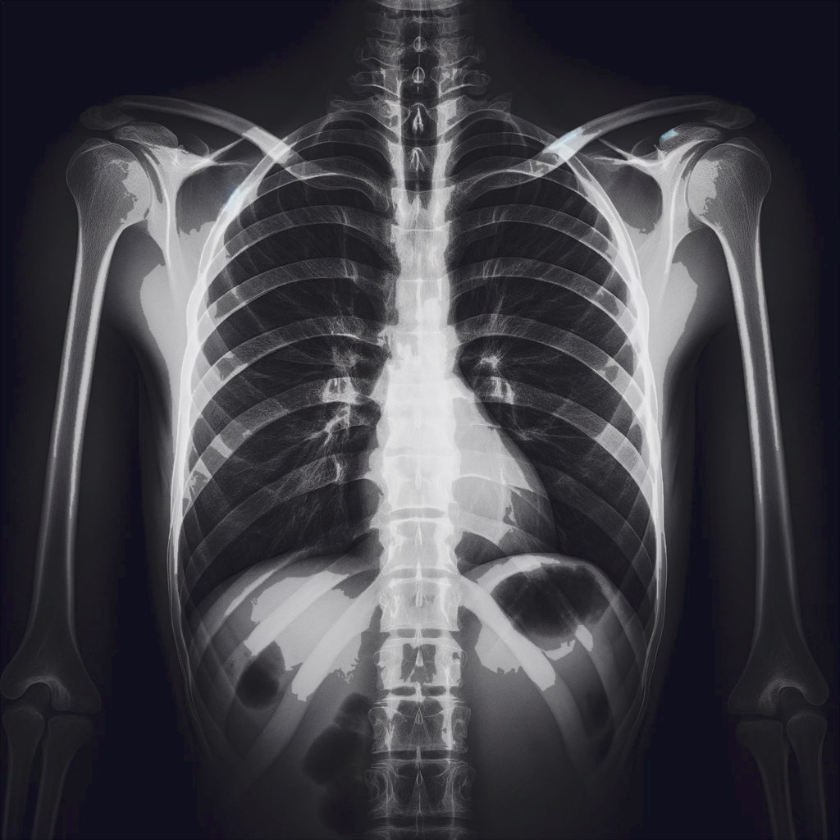
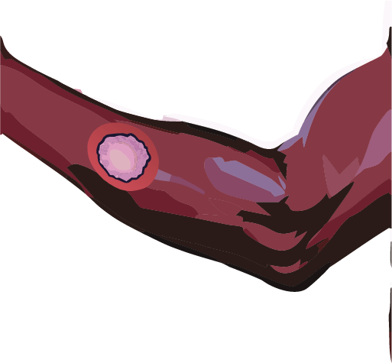

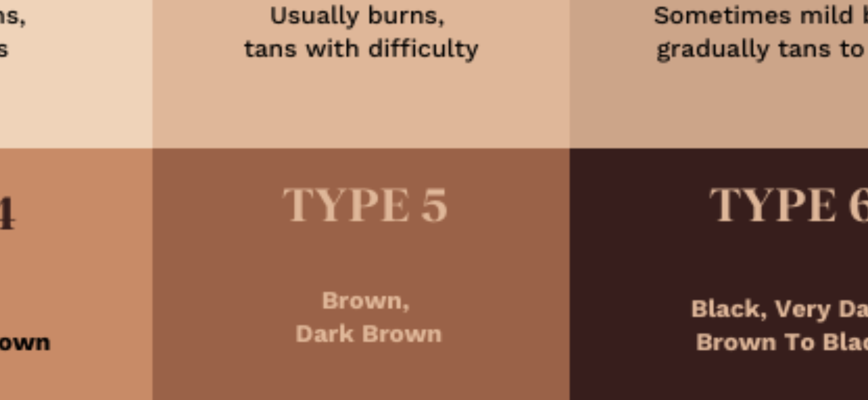







Chest X-rays
Skin Images
Malignant
Benign
FST
Responses
Malignant
Gemini Pro
Vision
x
> The lesion is benign.
Benign
API
API
Refusals
Text Prompts
> As an AI model, I cannot diagnose…
P1
P2
Refusal Rate
GPT-4 with Vision
P1 | GPT-4 | Gemini
P2
…
P8
P3
P4
P5
P6
Prompt Engineering
P7
P8
Malignant or Benign?
Images are paintings
You are an expert dermatologist
This is a matching game

